Slide 1
St Paul’s BYOD Information Evening
2017

Slide 2
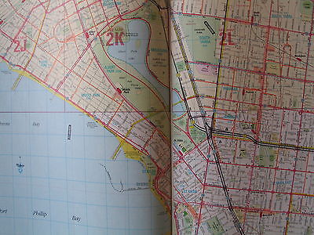
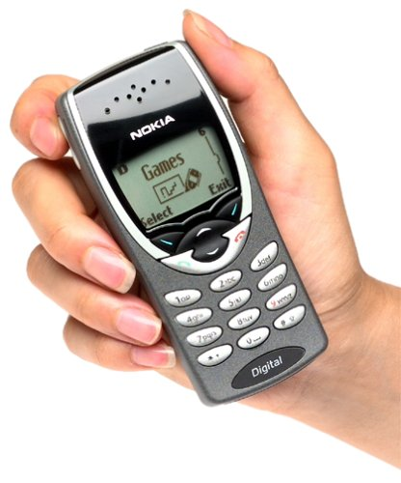
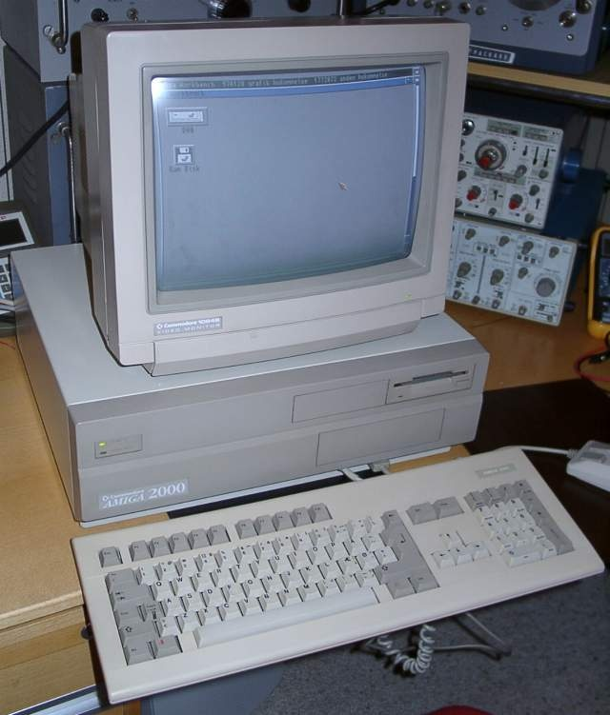
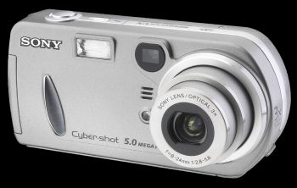
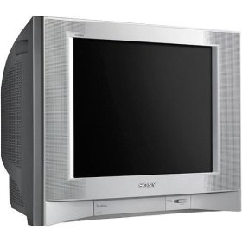
Technology in 2003
Notes:
(1) There was no broadband – we still used dial-up internet (ADSL came to Australian 2004)
(2) We still spoke in person (Facebook, Twitter and Social Media were not a thing! Even MySpace was a year off
(3) Most of us still brought CDs (iPod had only just arrived, and iTunes launched for the US market late in 2004)
(4) We were ruled by cables (no WiFi, Bluetooth, Apple TV or Chromecast)
(5) We still had cameras (our phones made calls and sent texs)
(6) We still read physical books (Kindle arrived 2007)
(7) We still used maps (Google Maps arrived in 2005)
(8) We still watched television (YouTube was still two years away, Netflix 3 years and only few people had a DVD player)
(9) We still watched television on huge CRT screens (because nobody could afford the $40,000 LCD televisions!)
(10) We still had laptops and desktops (iPad only arrived in 2010)

Slide 3
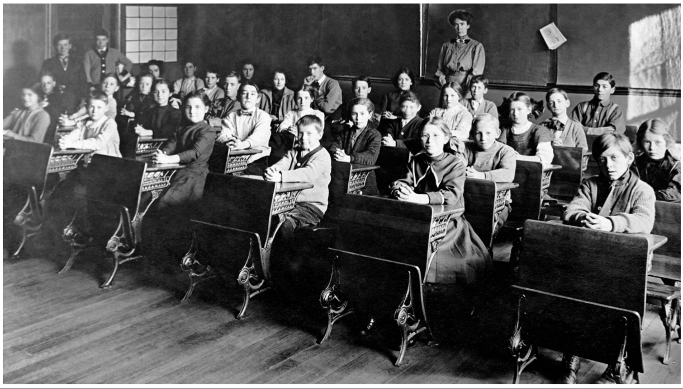
Notes:
School in the 20th century – industrial age
Seated in rows
Teacher was the font of all wisdom and knowledge
Worked in isolation
Followed rules – order – structure
School was a production line

Slide 4
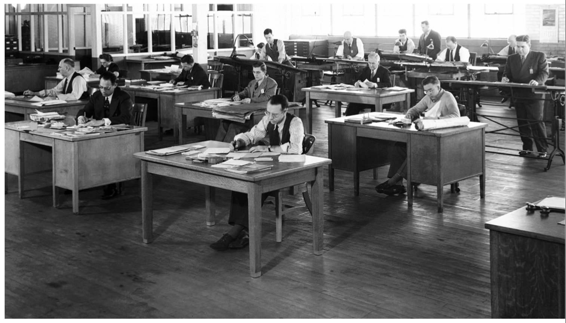
Notes:
Employment in the 20th century - industrial age
“production line”
Manufacturing, process orientated work (eg accounting, book keeping, administration)
Did what the boss told you
Education reflected the needs of the industrial age.

Slide 5
Disruptive Innovation
Notes:
Has fundamentally changed the way we do things.
Globalization has seen many jobs erased from Australia, eg manufacturing –(can be moved off shore – China, India etc). This has snuck up on us in the last 20 years – disruptive innovation.
Some blue collar jobs are location dependent (builders, cleaners etc) however many white collar jobs are not
– software allows routine cognitive work to be done overseas – call centres, book keeping, analysis of MRI’s etc.
Workers have to compete with a global workforce. (Personal assistants)
Work now comes to the worker (not vice versa). Also some tasks are automated – online tax returns, booking hotels etc. These jobs disappear.
“People who need constant managing will end up being unemployed and unemployable”
Increase in creative jobs (eg developing apps) and service jobs. Steady decline in agriculture and manufacturing/working sector. Schools were designed for the industrial workforce which is now gone. Students will need creative 21st century skills.
80-85% of work in school focuses on routine cognitive work (factual recall etc). No generation has been so thoroughly prepared for the industrial age as the current generation!! Students are disengaged and are dropping out of high school. 50% drop out of university before finishing their degree (in Australia)
Having a career for life is no longer the norm. In the new economy people will change their jobs 4-7 jobs by the time they are 38.

Slide 6
21st Century Skills
What did employers want in 1970?
What do employers want now?
Reading, Writing and Arithmetic
critical thinking
problem solving
collaboration
creativity
ability to use different media

Slide 7
Notes:
We need to use technology the right way.
Encourage 21st skills
OneNote – collaboration
Better more frequent feedback
Increased in communication between students and teachers – Video conferencing
Opportunities to be more creative and present information in different ways (Adobe creative cloud in TAS, Visual arts and all subjects)
Opportunities to solve real world problems using technology (Database and web design for local businesses)
Science – makey-makey (electrical wired devices that control your computer)
Robotics
Efficiencies:
Text books
Taking notes
Home study (hotmaths + education perfect)
Online organization (calendar/diary, notifications etc)
Teachers continually looking for new ways to engage students and develop 21st C skills

Slide 8
St Paul’s BYOD Information Evening
Getting the most from your device

Slide 9
In this session…..
1. PC Health
2. Tips and Trouble shooting

Slide 10
PART 1: PC Health

Slide 11
At school….
Always use a good protective case
Be mindful of your device and of other students devices

Slide 12
At home
Charge your device every day
Check for windows updates
“Shutdown” your device regulary (don’t just close the lid!)

Slide 13
Virus protection
Windows defender is sufficient
Uninstall trial software when it expires

Slide 14
Look for the signals of trouble
Overheating/noisy fan
Running slow
Freezing
Applications not working properly/crashing
Error messages
Do NOT ignore these. Get help!!

Slide 15
Scams
Adware, custom toolbars
Spyware
Email scams
Ask these questions:
“Is this a trusted website”
“Is it ‘click-bait’”
“Do I really need to download this software (or open this email)?”

Slide 16
Be a critical thinker!
A boy left his bike chained to a tree when he went away to war in 1914. He never returned, leaving the tree no choice but to grow around the bike. Incredible that this bike has been there for 98 years now!

Slide 17
Be organised
Keep your hard drive tidy;
Delete unnecessary files and applications
Empty the recycle bin
Check how much free hard drive space you have (search ‘storage’)
Use OneDrive (auto backup)
Remove old versions of office ( + X >Programs and features>uninstall)

Slide 18
PART 2: Tips and Troubleshooting

Slide 19
What to do if your computer is not working properly.
Turn it off and on! (restart)
If it wont turn off, press and hold power button for 10 seconds
Check the Wi-Fi button (also check function keys)
Remove and replace battery (if possible)
Unplug and plug in peripherals (mouse, printer etc)

Slide 20
What to do if your internet is not working properly.
Reinstall the z-scaler certificate (see instructions on MN Connect)
Retype your password if it is saved (check capslock key ?)
Disconnect and reconnect your connection to the Wi-Fi network (click Wi-Fi icon at bottom right or your screen)
Try a different web browser (Internet explorer, Edge, Chrome)
“Logout” button on MNConnect

Slide 21
What to do if your apps are not working properly.
Close all programs and restart your computer
Check for Windows updates (install and restart)
Look in Task manager (CNTRL + ALT + DEL) for unusual activity
Run Microsoft Office repair for Word, Excel, PowerPoint etc)
( + X> Programs and features> Microsoft Office >change)

Slide 22
Some tips…
Get accidental damage insurance
Use ‘calendar’ as your diary
Add shortcuts to your task bar (right click>”pin to task bar”)
Keyboard shortcuts
+ E opens file explorer
+ M minimize all windows
+ X quick links
Cntrl + P print
Alt + Tab switch between apps

Slide 23
Helpful apps…
Office lens
Snipping tool

Slide 24
Questions?

